Slide 1
Team Speculator
US Trade Data Analysis
Alex Carter, Justin Kim, Tao Tianyu, Mike McPartlin

Slide 2
Research Questions
Which states contribute most/least to the US export total? Has this changed over time?
Which countries import the most from the US? Has this changed over the past decade?
Which variables impact the amount the US exports to other countries?

Slide 3
Data
US export data from 2007 to 2017
US Census data
GDP data by country
Population by country
Distances from US

Slide 4
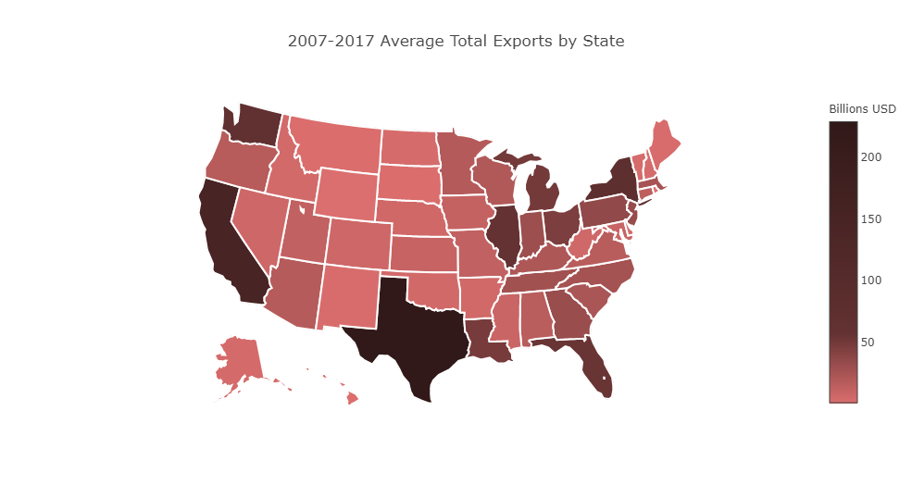
Export Data by State

Slide 5
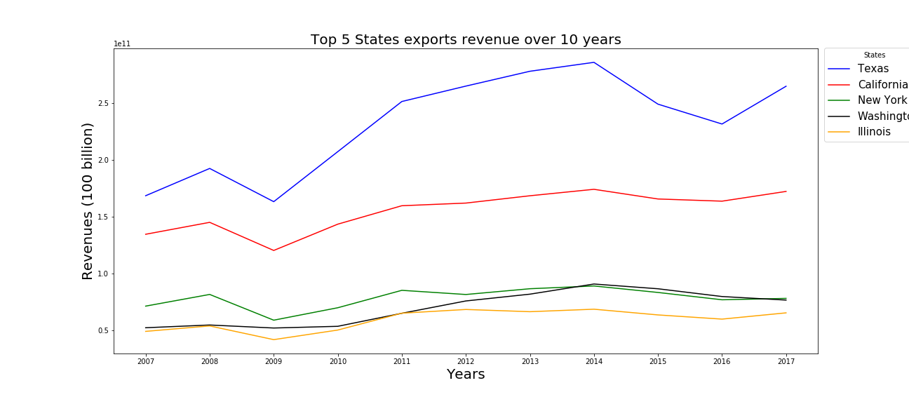
Export Data by State

Slide 6
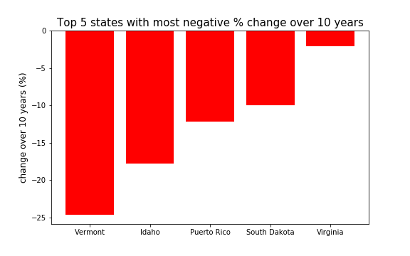
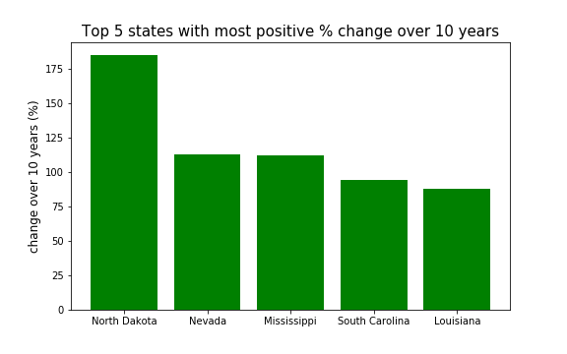
Export Data by State

Slide 7
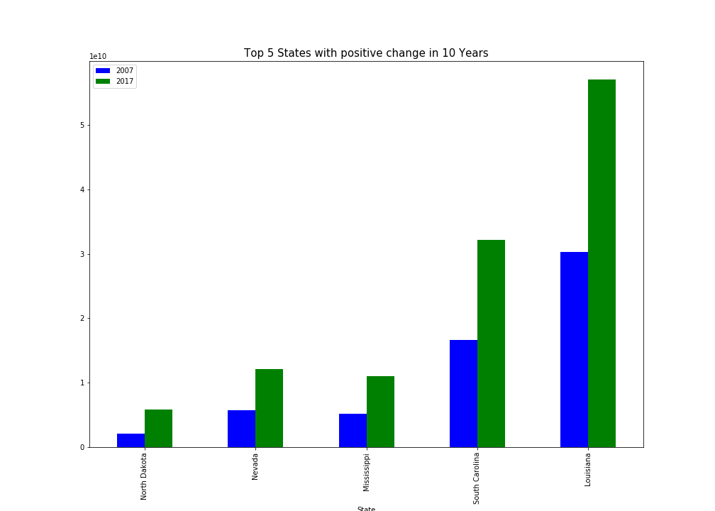
Export Data by State

Slide 8
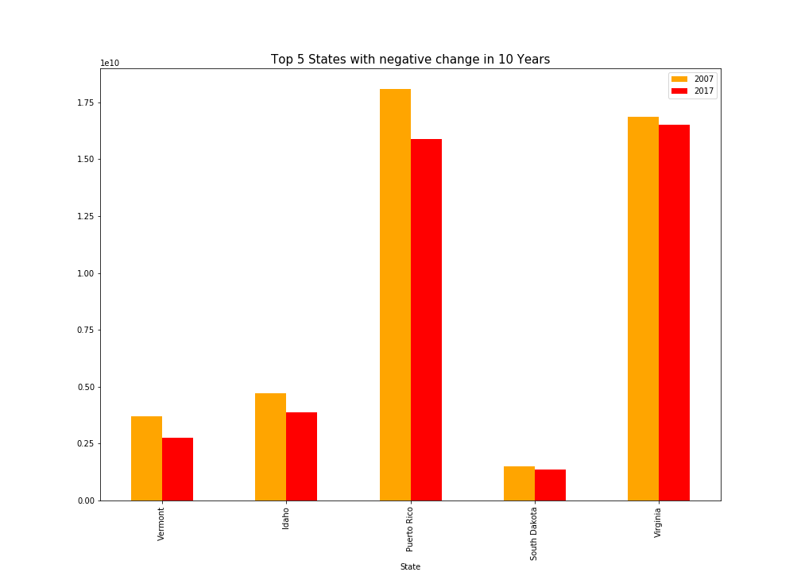
Export Data by State

Slide 9
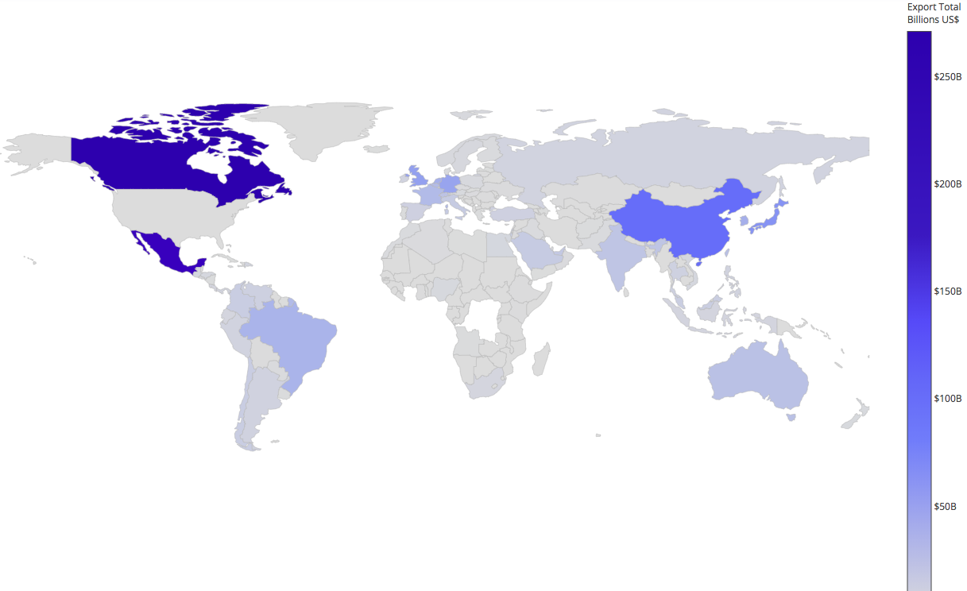
Export Data by Country

Slide 10
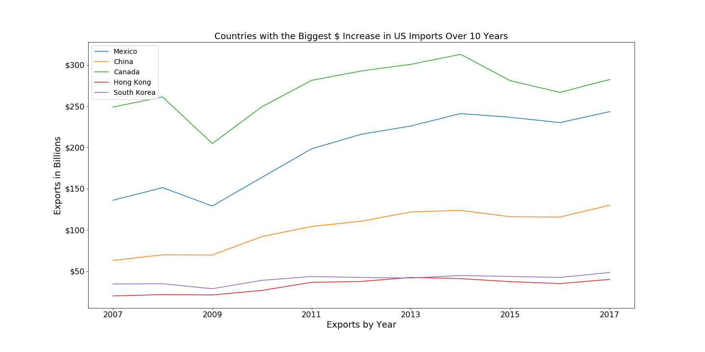
Export Data by Country

Slide 11
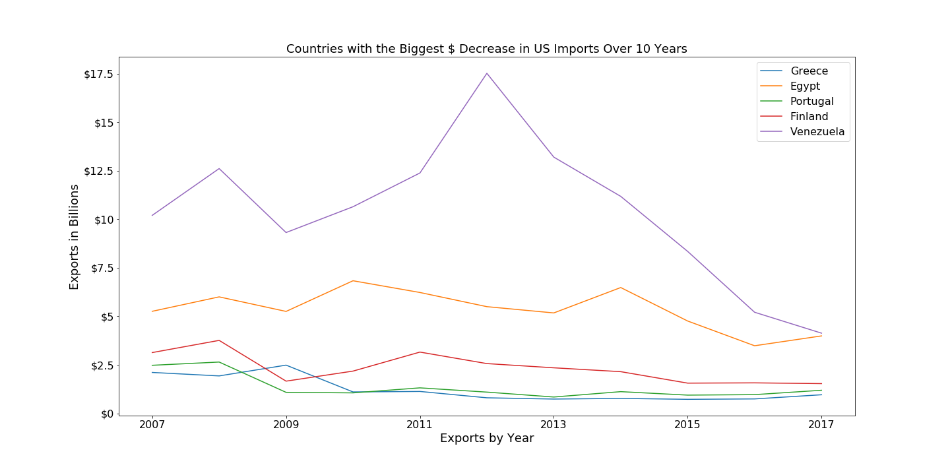
Export Data by Country

Slide 12
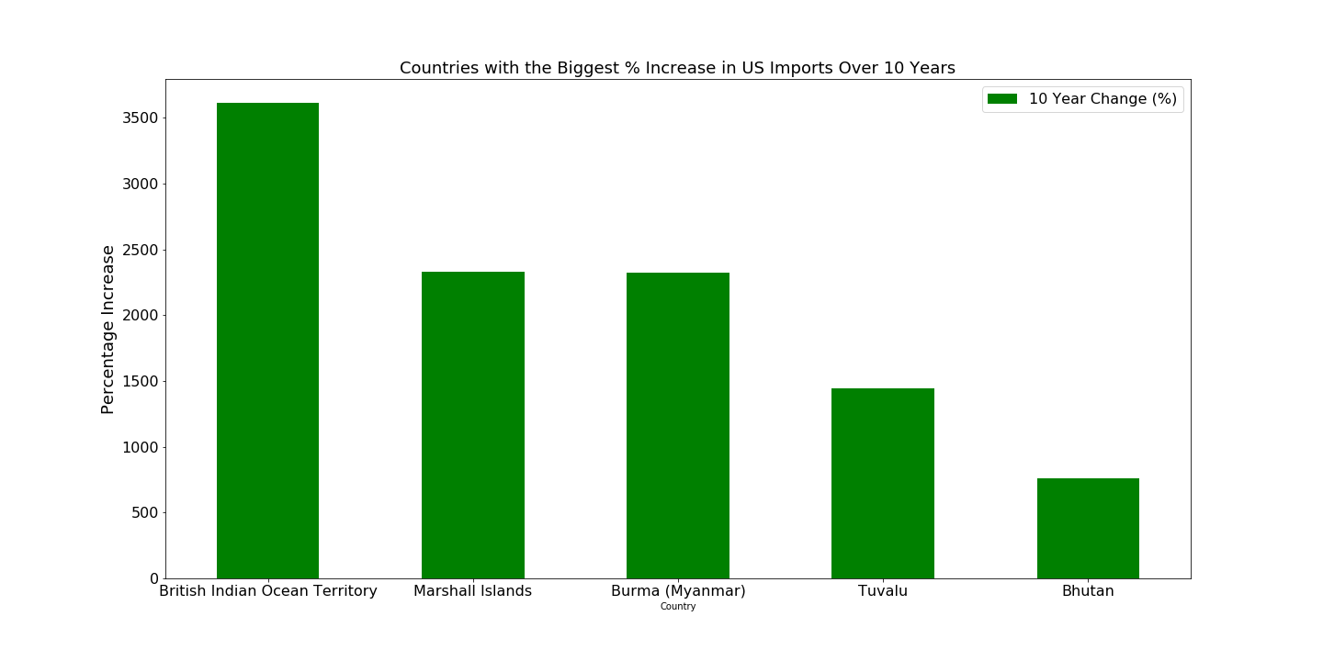
Export Data by Country

Slide 13
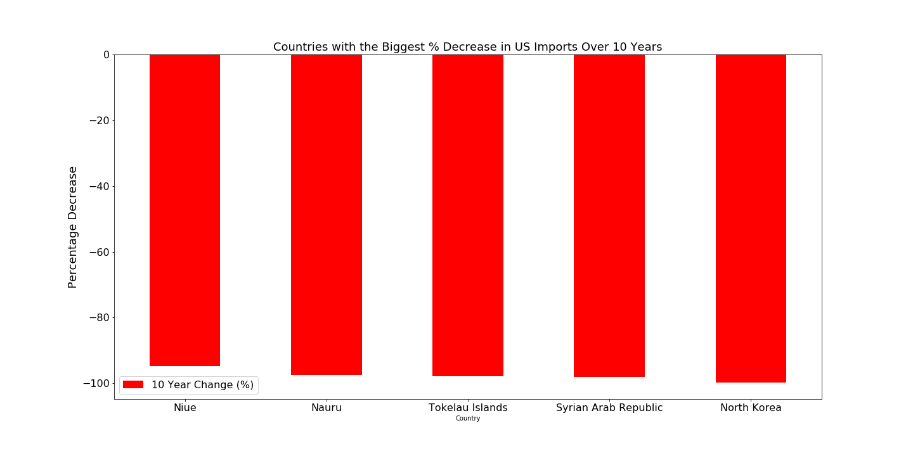
Export Data by Country

Slide 14
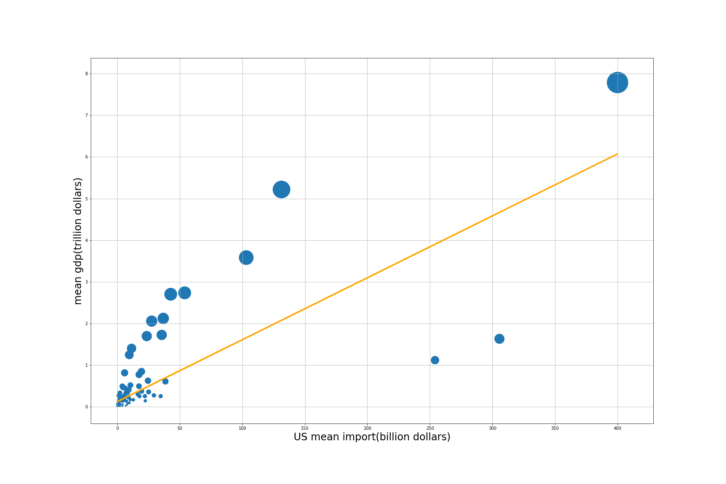
Mean GDP vs Mean Import

Slide 15
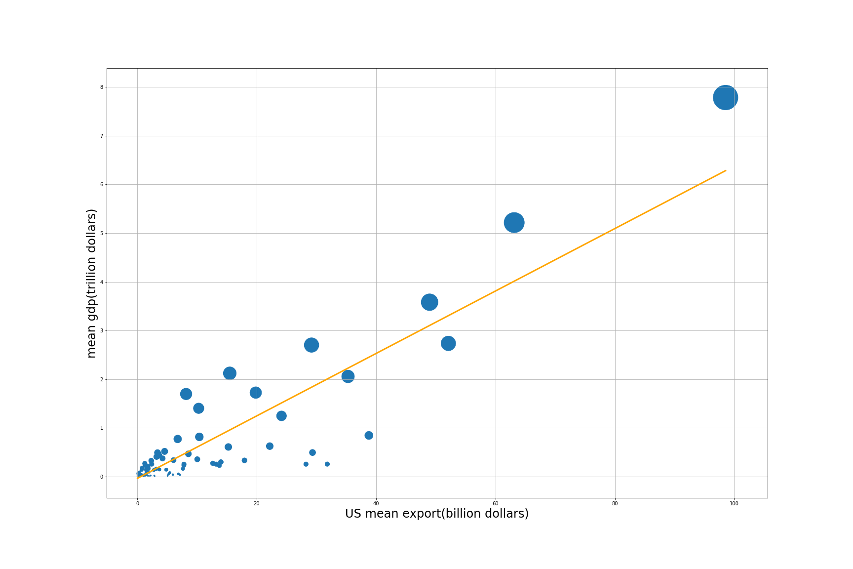
Mean GDP vs. Mean Export

Slide 16
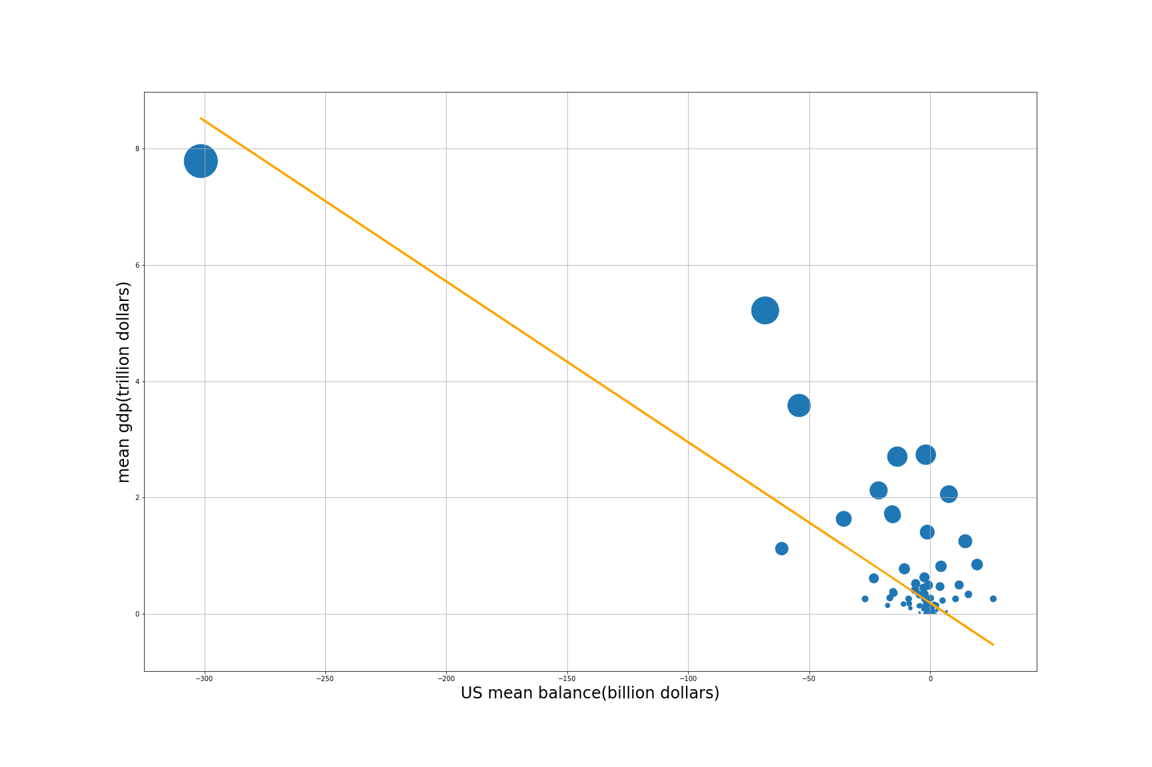
Mean GDP vs. Mean Balance

Slide 17
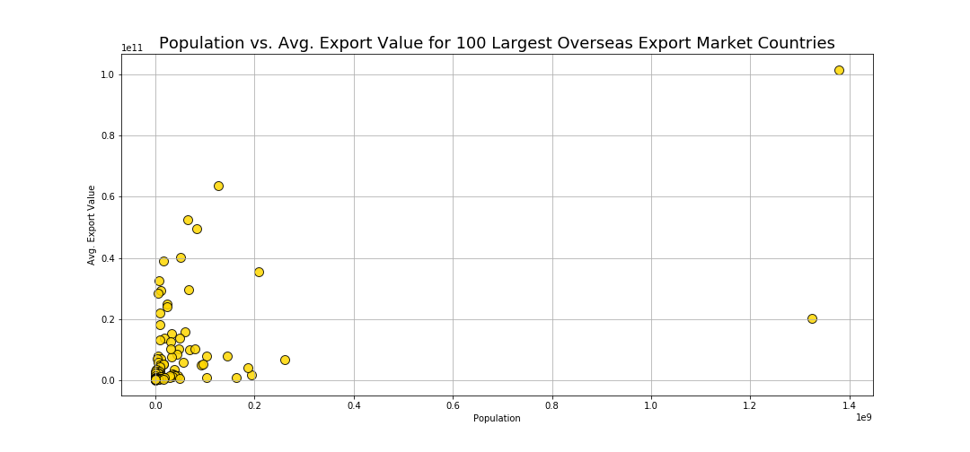
Population vs. Avg Export Value

Slide 18
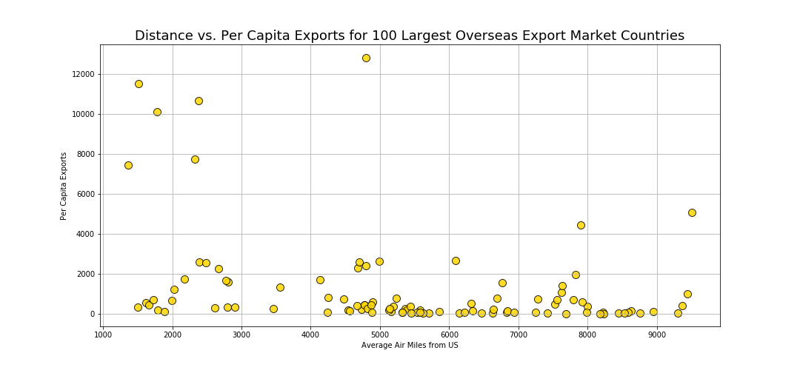
Distance vs. Per Capita Exports

Slide 19
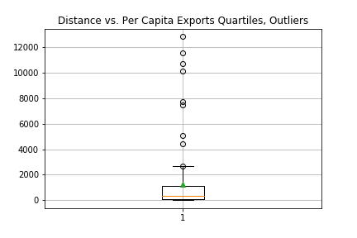
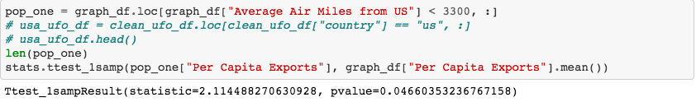
Distance vs. Per Capita Exports

Slide 20
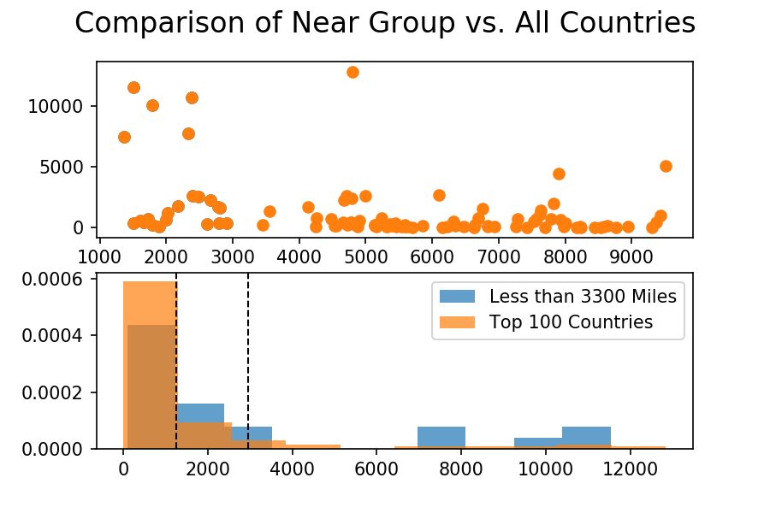
Near Group vs. All Countries

